Slide 1
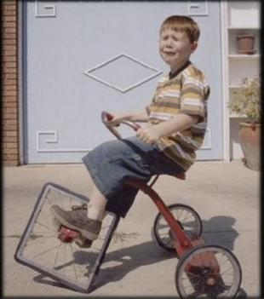
Uneasy Rider ? The Challenge to a Ministry of Word and Sacrament in a Post-Christendom Missional Climate

Slide 2
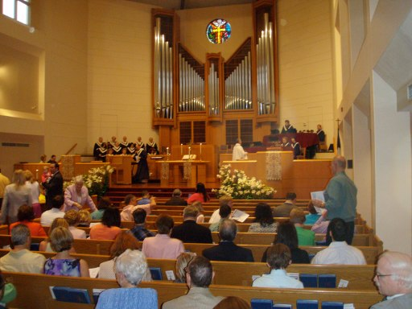

Slide 3
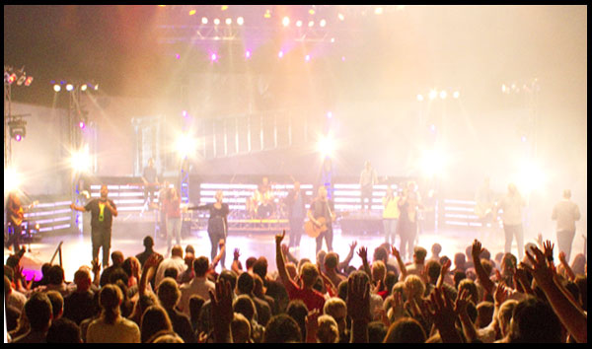


Slide 4
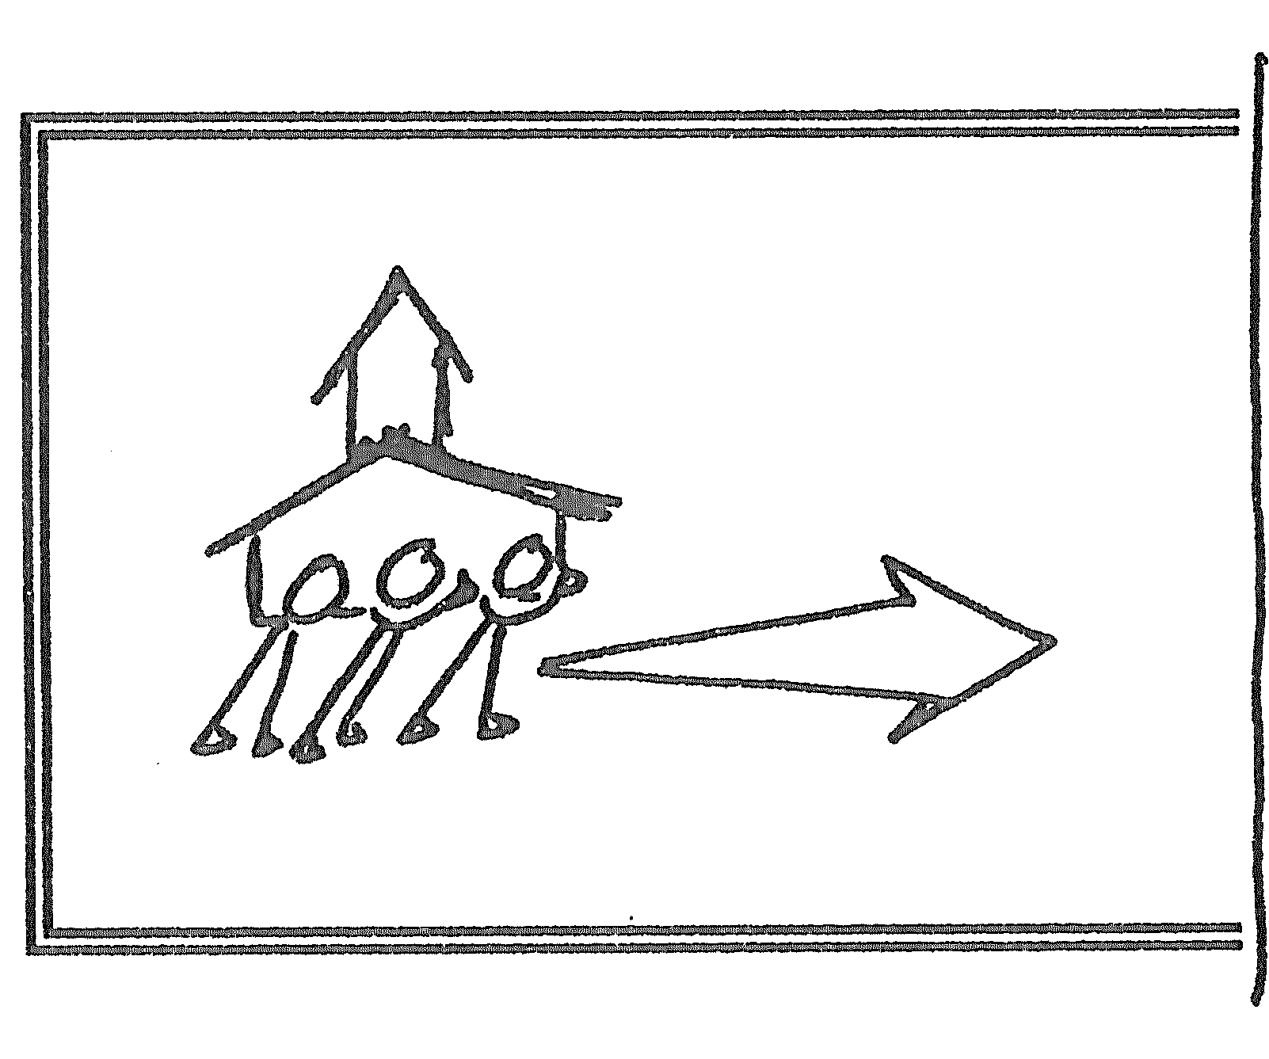
The Church in Mission 1

Slide 5
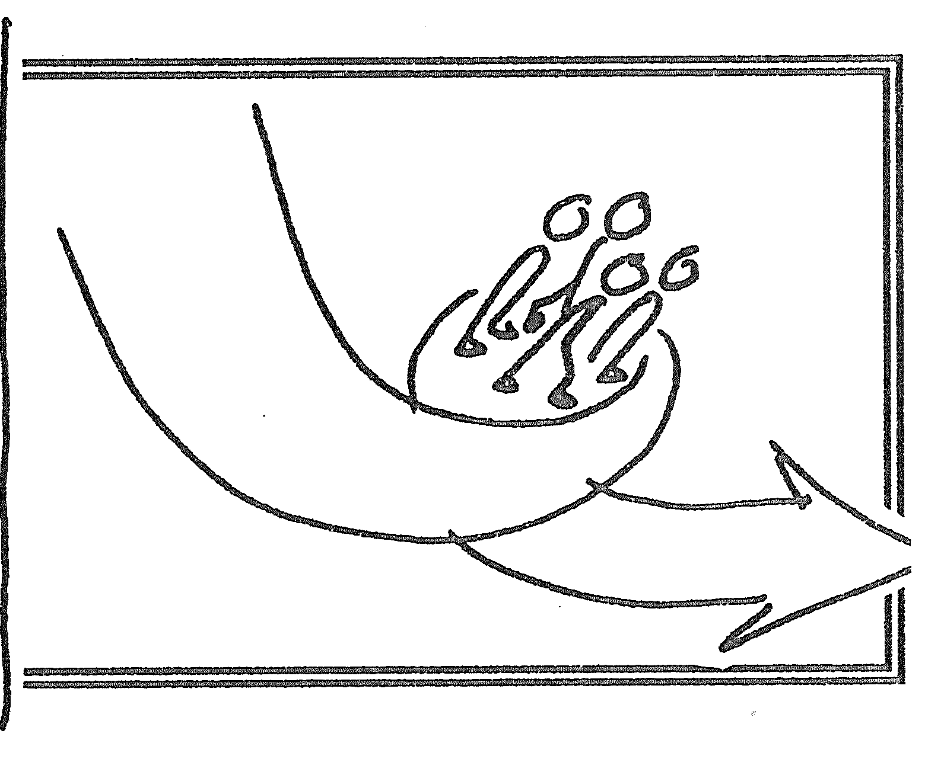
The Church in Mission 2

Slide 6
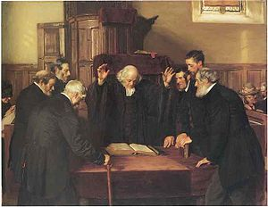
The disabling imagination formed from Presbyterian polity

Slide 7
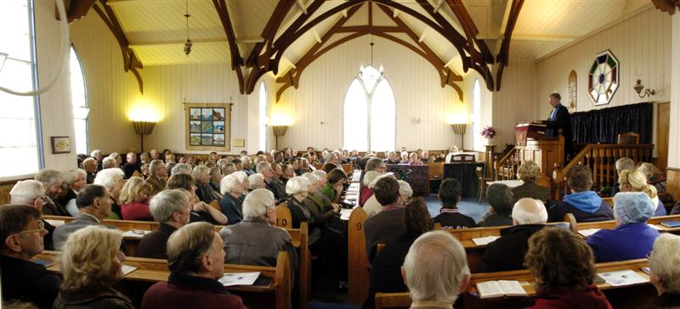
The disabling imagination formed from denominationalism

Slide 8

The disabling imagination formed from disembodied spirituality

Slide 9
“Consumerism is making disciples better than the church. We think that by people turning up for two hours on a Sunday to listen to a sermon and sing a few songs, we are forming disciples who will influence culture and benefit society ? Who are we kidding ?”
Bishop Graham Cray on consumer shaped citizenship. Public lecture NZ July 2010

Slide 10
How might we respond to the challenge of disabling church imaginations ?

Slide 11
Does Pastoral care shape and socialise people to live as a community of the Gospel, or does it simply re-inforce expressive individualism ?
Do community outreach initiatives actually allow for transforming participation in God’s agency or do they reinforce an instrumental works centred church agency ?
Does Christian education nurture people in a patterned way of life that dethrones the powers, frees from cultural captivities, generates courageous action or does it suggest an accommodation to disembodied spiritualities ?
Do the actions at worship sign and dwell in the truth of a world reconstituted in the resurrection of Christ or are they habituating us to a world of fears, social fragments and continued abstraction.
Does our church governance practice bring forth a fruitful priest-hood of all believers or does it further entrench a Protestant sacredotalism?

Slide 12
